Slide 1
How Does The Weight Of A Paper Airplane Affect Its Ability To Fly?
Scarlett Fan
3rd Grade
Sreibers

Slide 2
Question/Phenomenon Noticed:
How Does The Weight Of A Paper Airplane Affect Its Ability To Fly?

Slide 3
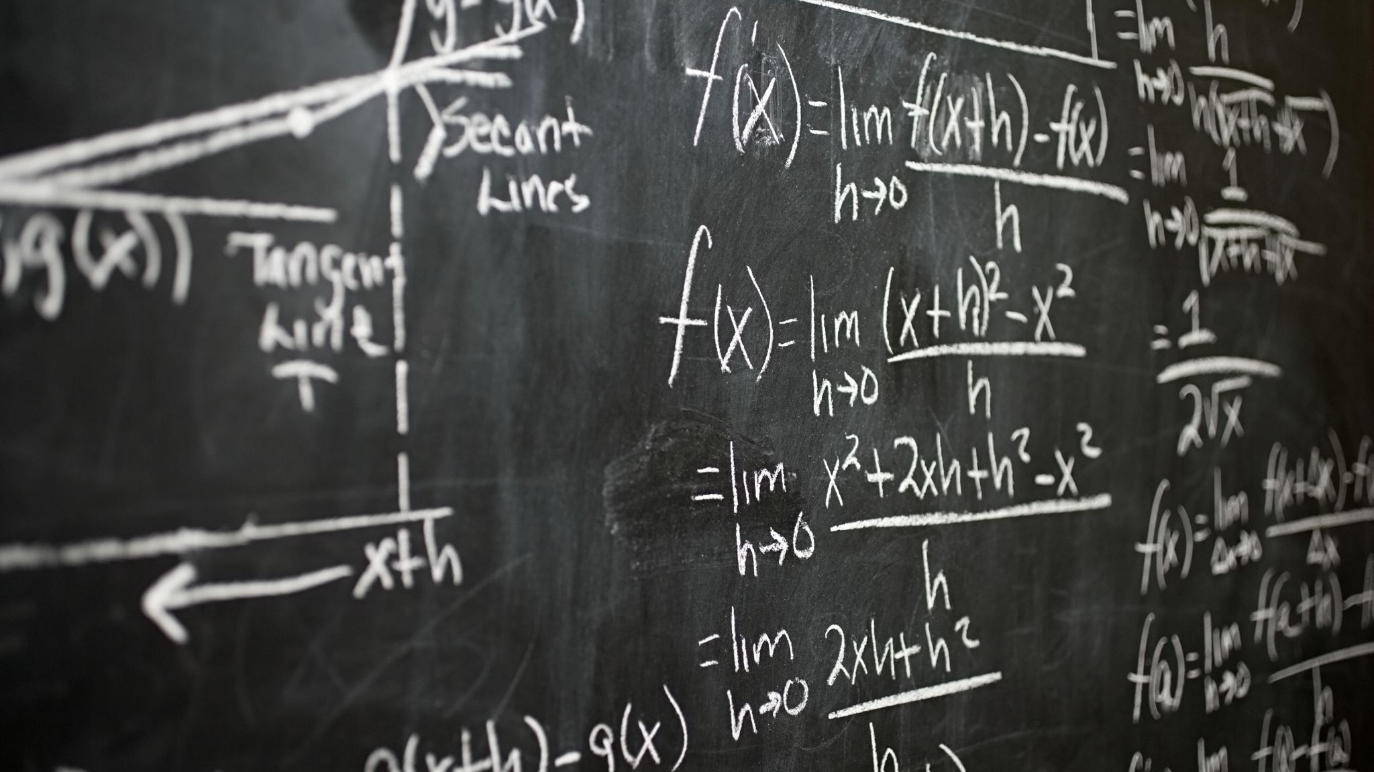
Hypothesis
I think that airplanes with more weight to bear will fly more heavily and descend much sooner than lighter airplanes.

Slide 4
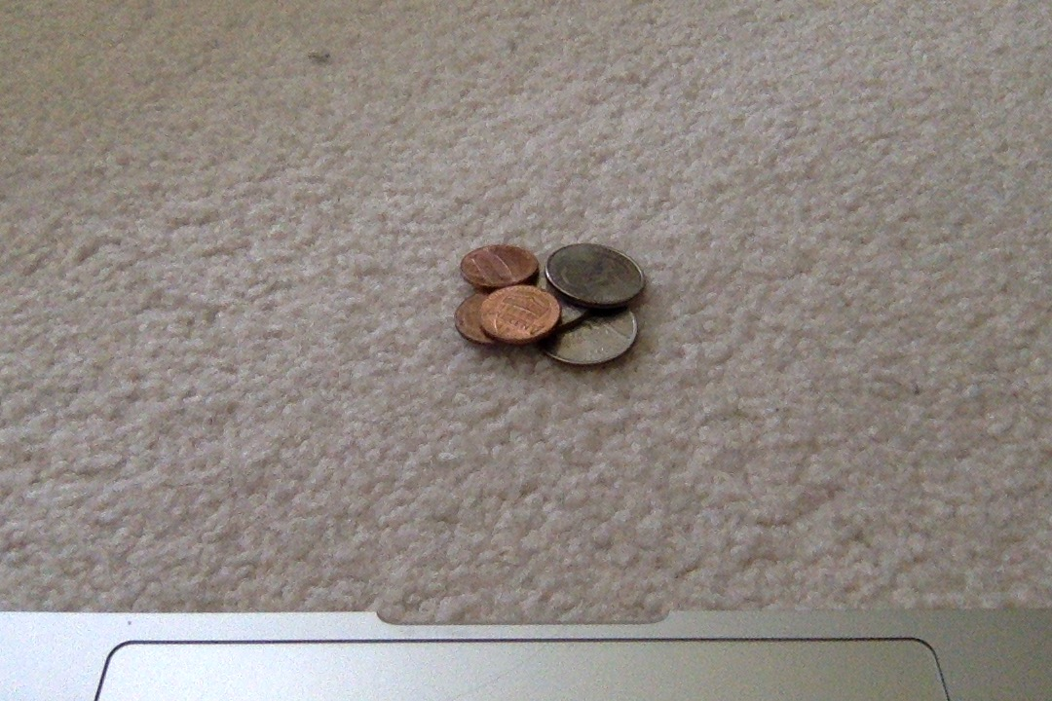
Materials
1) 4 sheets of paper to fold into identical paper airplanes.
2) 3 pennies and 1 quarter, which will later be taped onto the airplanes.
3) Tape to tape the coins onto the airplanes.
4) A clear area to throw the airplanes one-by-one.

Slide 5
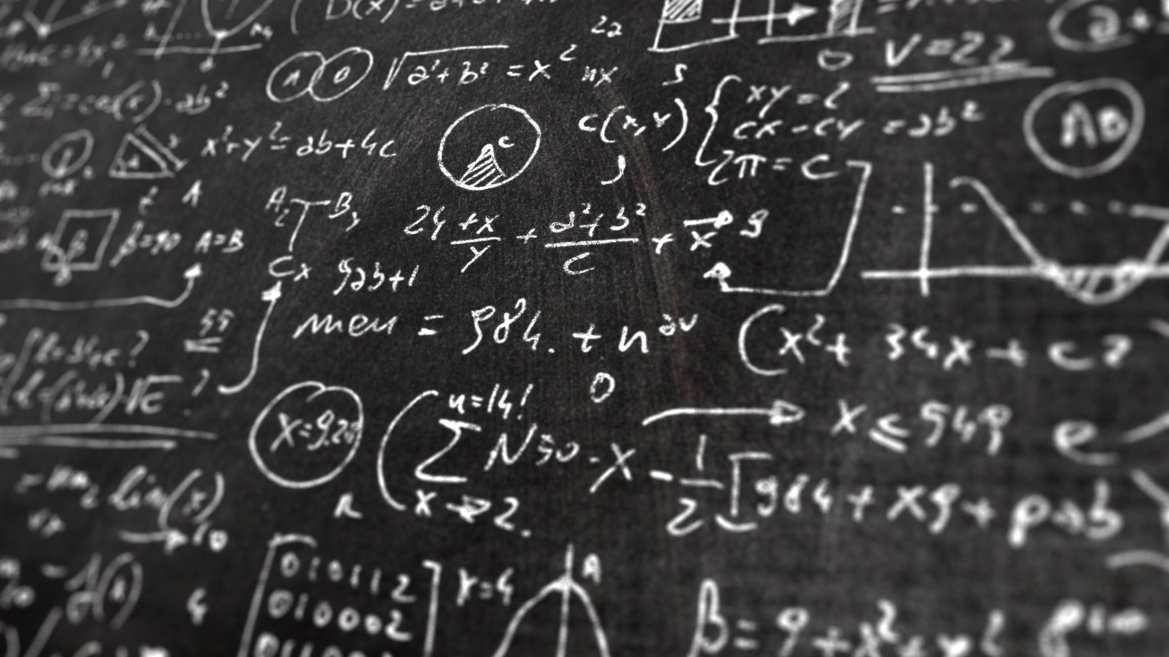
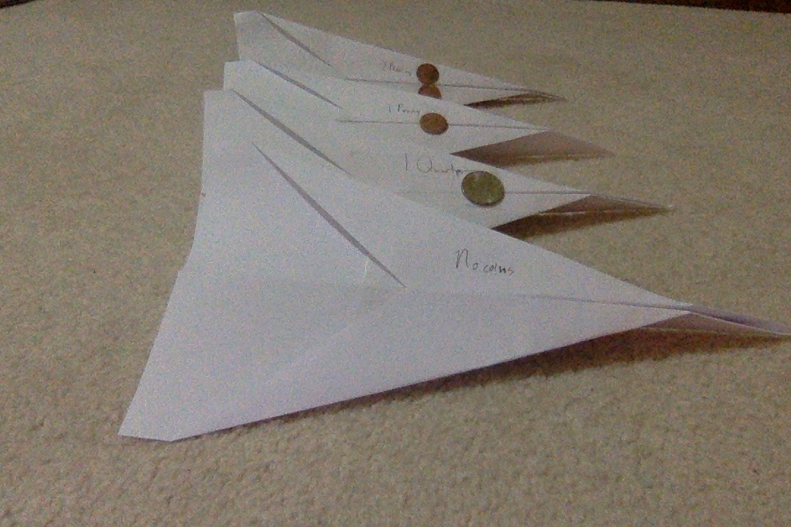
Procedure to Test Hypothesis
To test my hypothesis, I will make 4 identical paper airplanes and put one to the side. Next, I will tape a single penny to the second, a quarter to the third, and two pennies to the last.
Then I will throw each airplane and note how far it went. This will tell me whether my hypothesis is correct or not.

Slide 6
Variables
Manipulated variables: 4 paper airplanes and 4 coins; 3 pennies, 1 quarter
Responding variables: The distance each airplane will fly before dropping to the ground, and how well the airplanes' flights went.
Controlled Variables: The way the paper airplanes are being folded.

Slide 7
Data
The heaviest airplane, with two pennies, went the farthest. The lightest, with no coins, came second, the second lightest with a quarter came third, and the one with a single penny didn't go as far as the others.

Slide 8
Analyze Data for Conclusion
The heaviest airplane going farthest shows that my hypothesis was incorrect, but the lightest being second supports by hypothesis. This makes my hypothesis mostly incorrect.

Slide 9
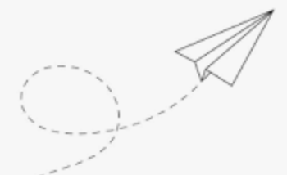

Slide 10
Conclusion
My question was how the weight on a paper airplane affected its ability to fly. My hypothesis was that heavier airplanes would land sooner, because gravity would pull on the heavier planes more than the lighter ones, so therefore I thought the heavier airplanes would make shorter flights.
In conclusion, my hypothesis, which was that heavier airplanes would not go very far, was incorrect because the heaviest airplane went farthest. My hypothesis could have been correct, because the strength used for throwing the airplanes could have been inconsistent.

